Slide 1



Slide 2


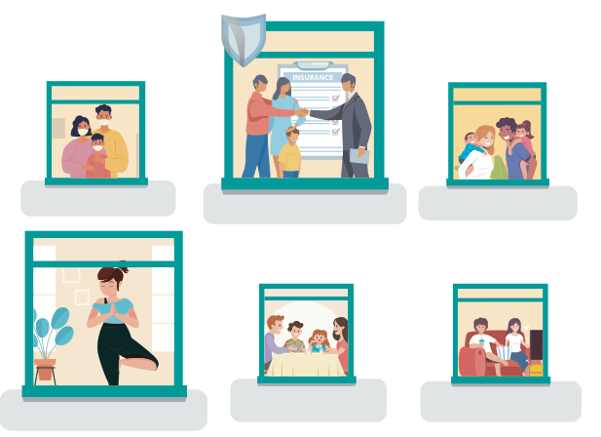

Family is living in anxiety
Insurance becomes necessity
Deeper family bond
Comeback of home-
cooking
Work-life-play balance
Healthy is the new caring
Source: https://www.yuswohady.com/2020/06/03/the-new-normal-100/

Slide 3
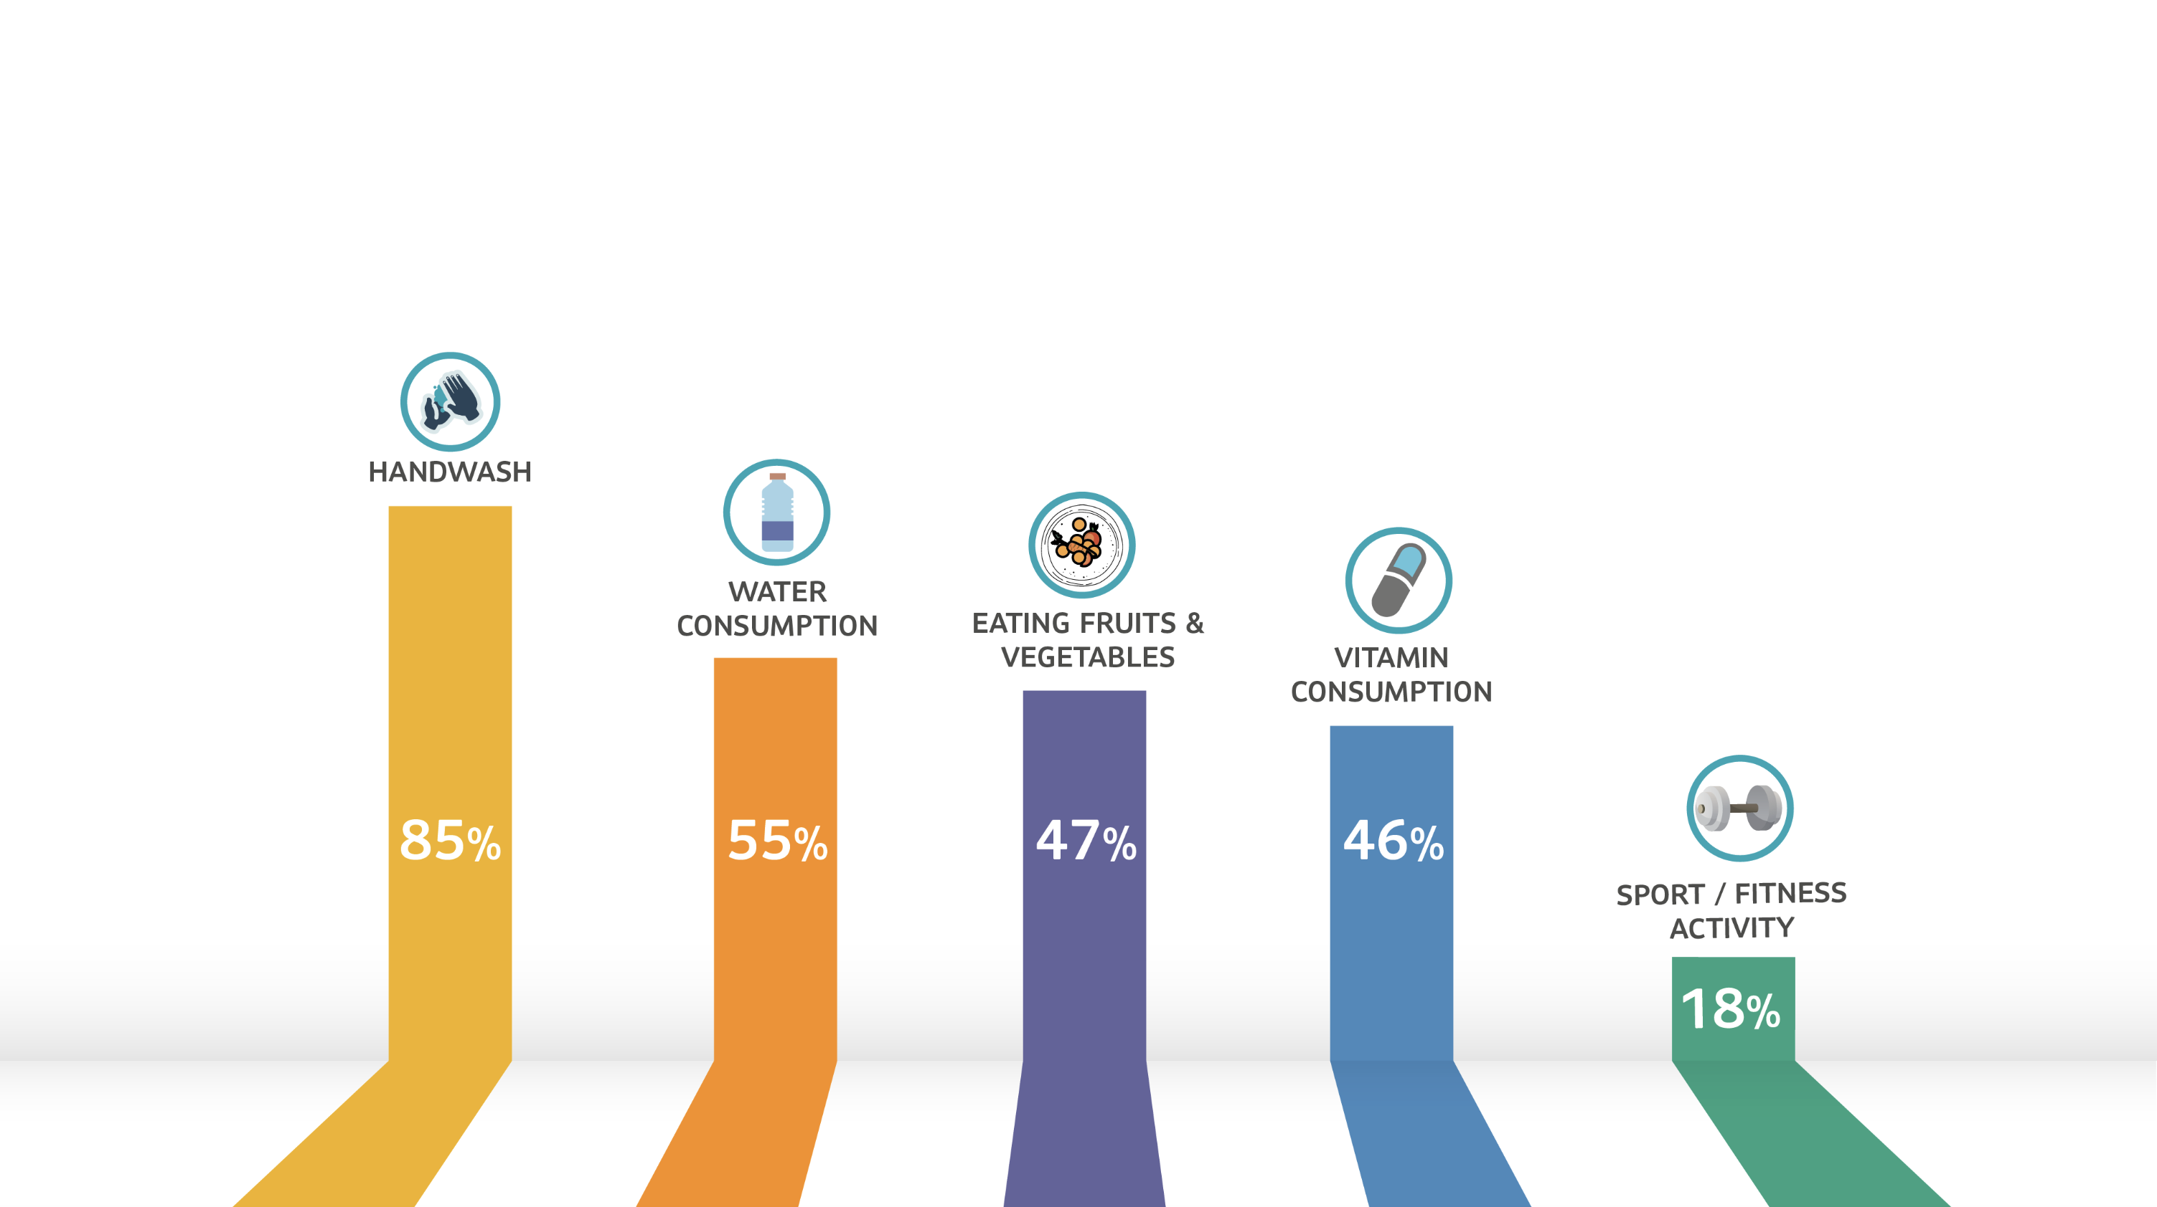
Consumers are shifting towards more “health & hygiene” focused lifestyle
Source :https://www.warc.com/newsandopinion/news/indonesia-gets-health-conscious-amid-covid-19-pandemic/43461

Slide 4


Slide 5

Survey Overview
Sun Life conducted an Asia-wide survey of first generation family business owners across a wide range of industries
It aims to understand owners’ viewpoints and how they operate in the region.
Total
respondents
Singapore

Slide 6










Q. If you or your key people suffer an incapacitating illness, how seriously will it affect the performance of your business?
Q. What do you have in place to protect your business?
67%
73%
73%
5%
62%
62%
60%
Not Really
concerned
56%
56%
51%
50%
44%
36%
95%
Serious
Employee health and accident
insurance
Personal health insurance,
e.g.e critical illness insurance,
medical insurance
Life insurance for key persons
46%
Moderately
Serious
Total Indonesia
Indonesia Start-up
Indonesia Growth
Indonesia Mature
54%
Very Serious
Source: Sun Life Asia Survey, The Future of Family Businesses in Asia

Slide 7


Q. When do you plan to retire?
Q. What do you have in place to protect your business?
Average desired retirement age :
44%
37%
Total Asia : 52 Years
ID Start-up : 47 Years
30%
65%
Total ID : 52 Years
ID Growth : 50 Years
ID Mature : 58 Years
Savings insurance or retirement annuity plan
Total Indonesia
Indonesia Start-up
Indonesia Growth
Indonesia Mature
Source: Sun Life Asia Survey, The Future of Family Businesses in Asia

Slide 8

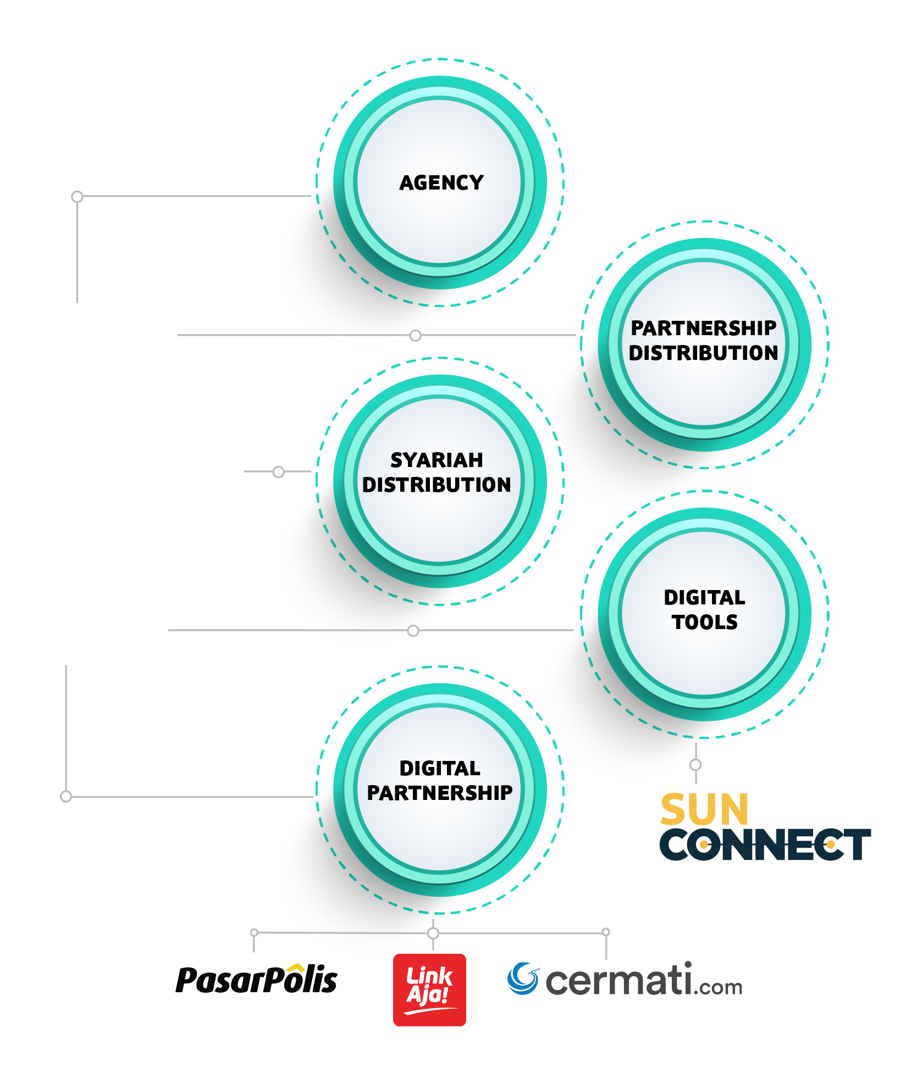
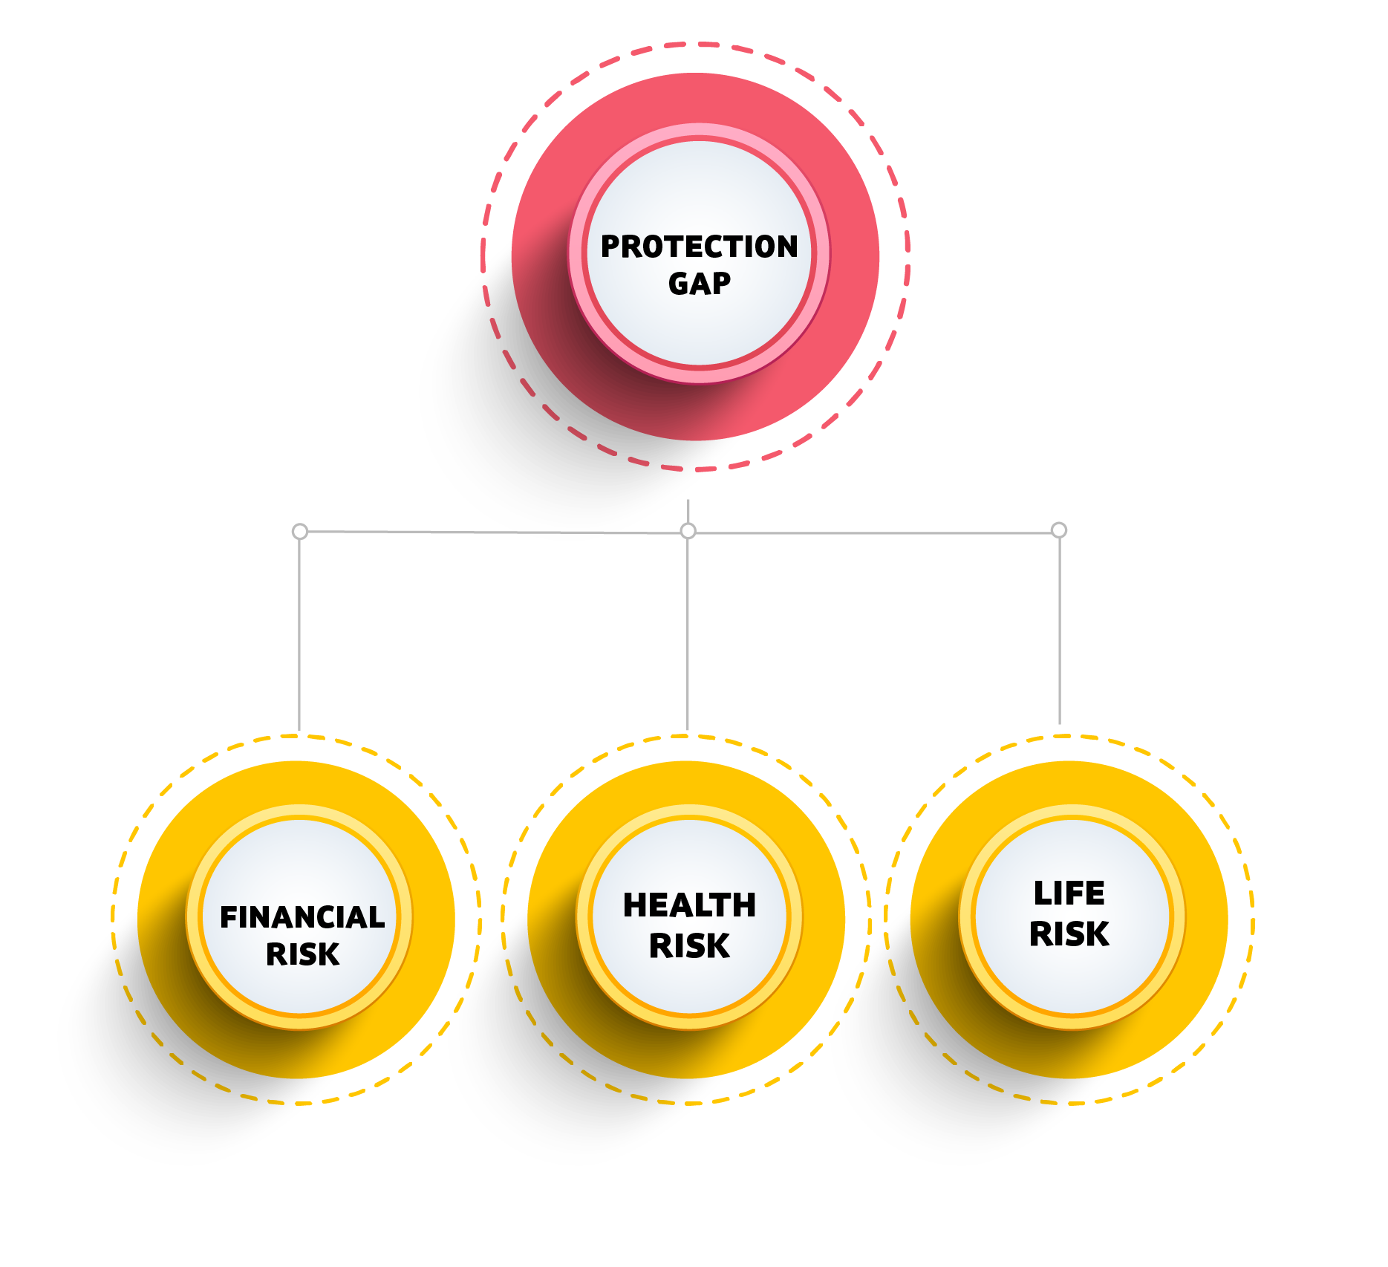
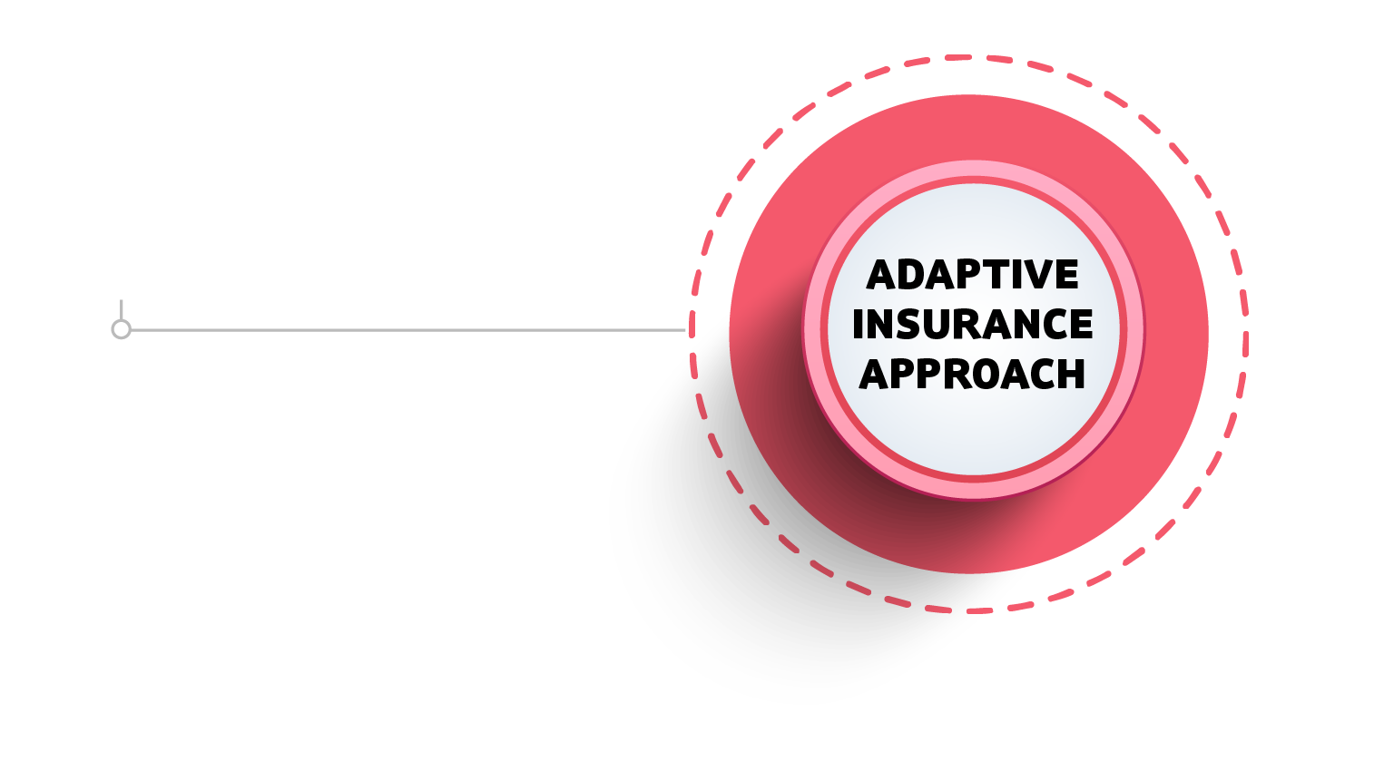

Slide 9
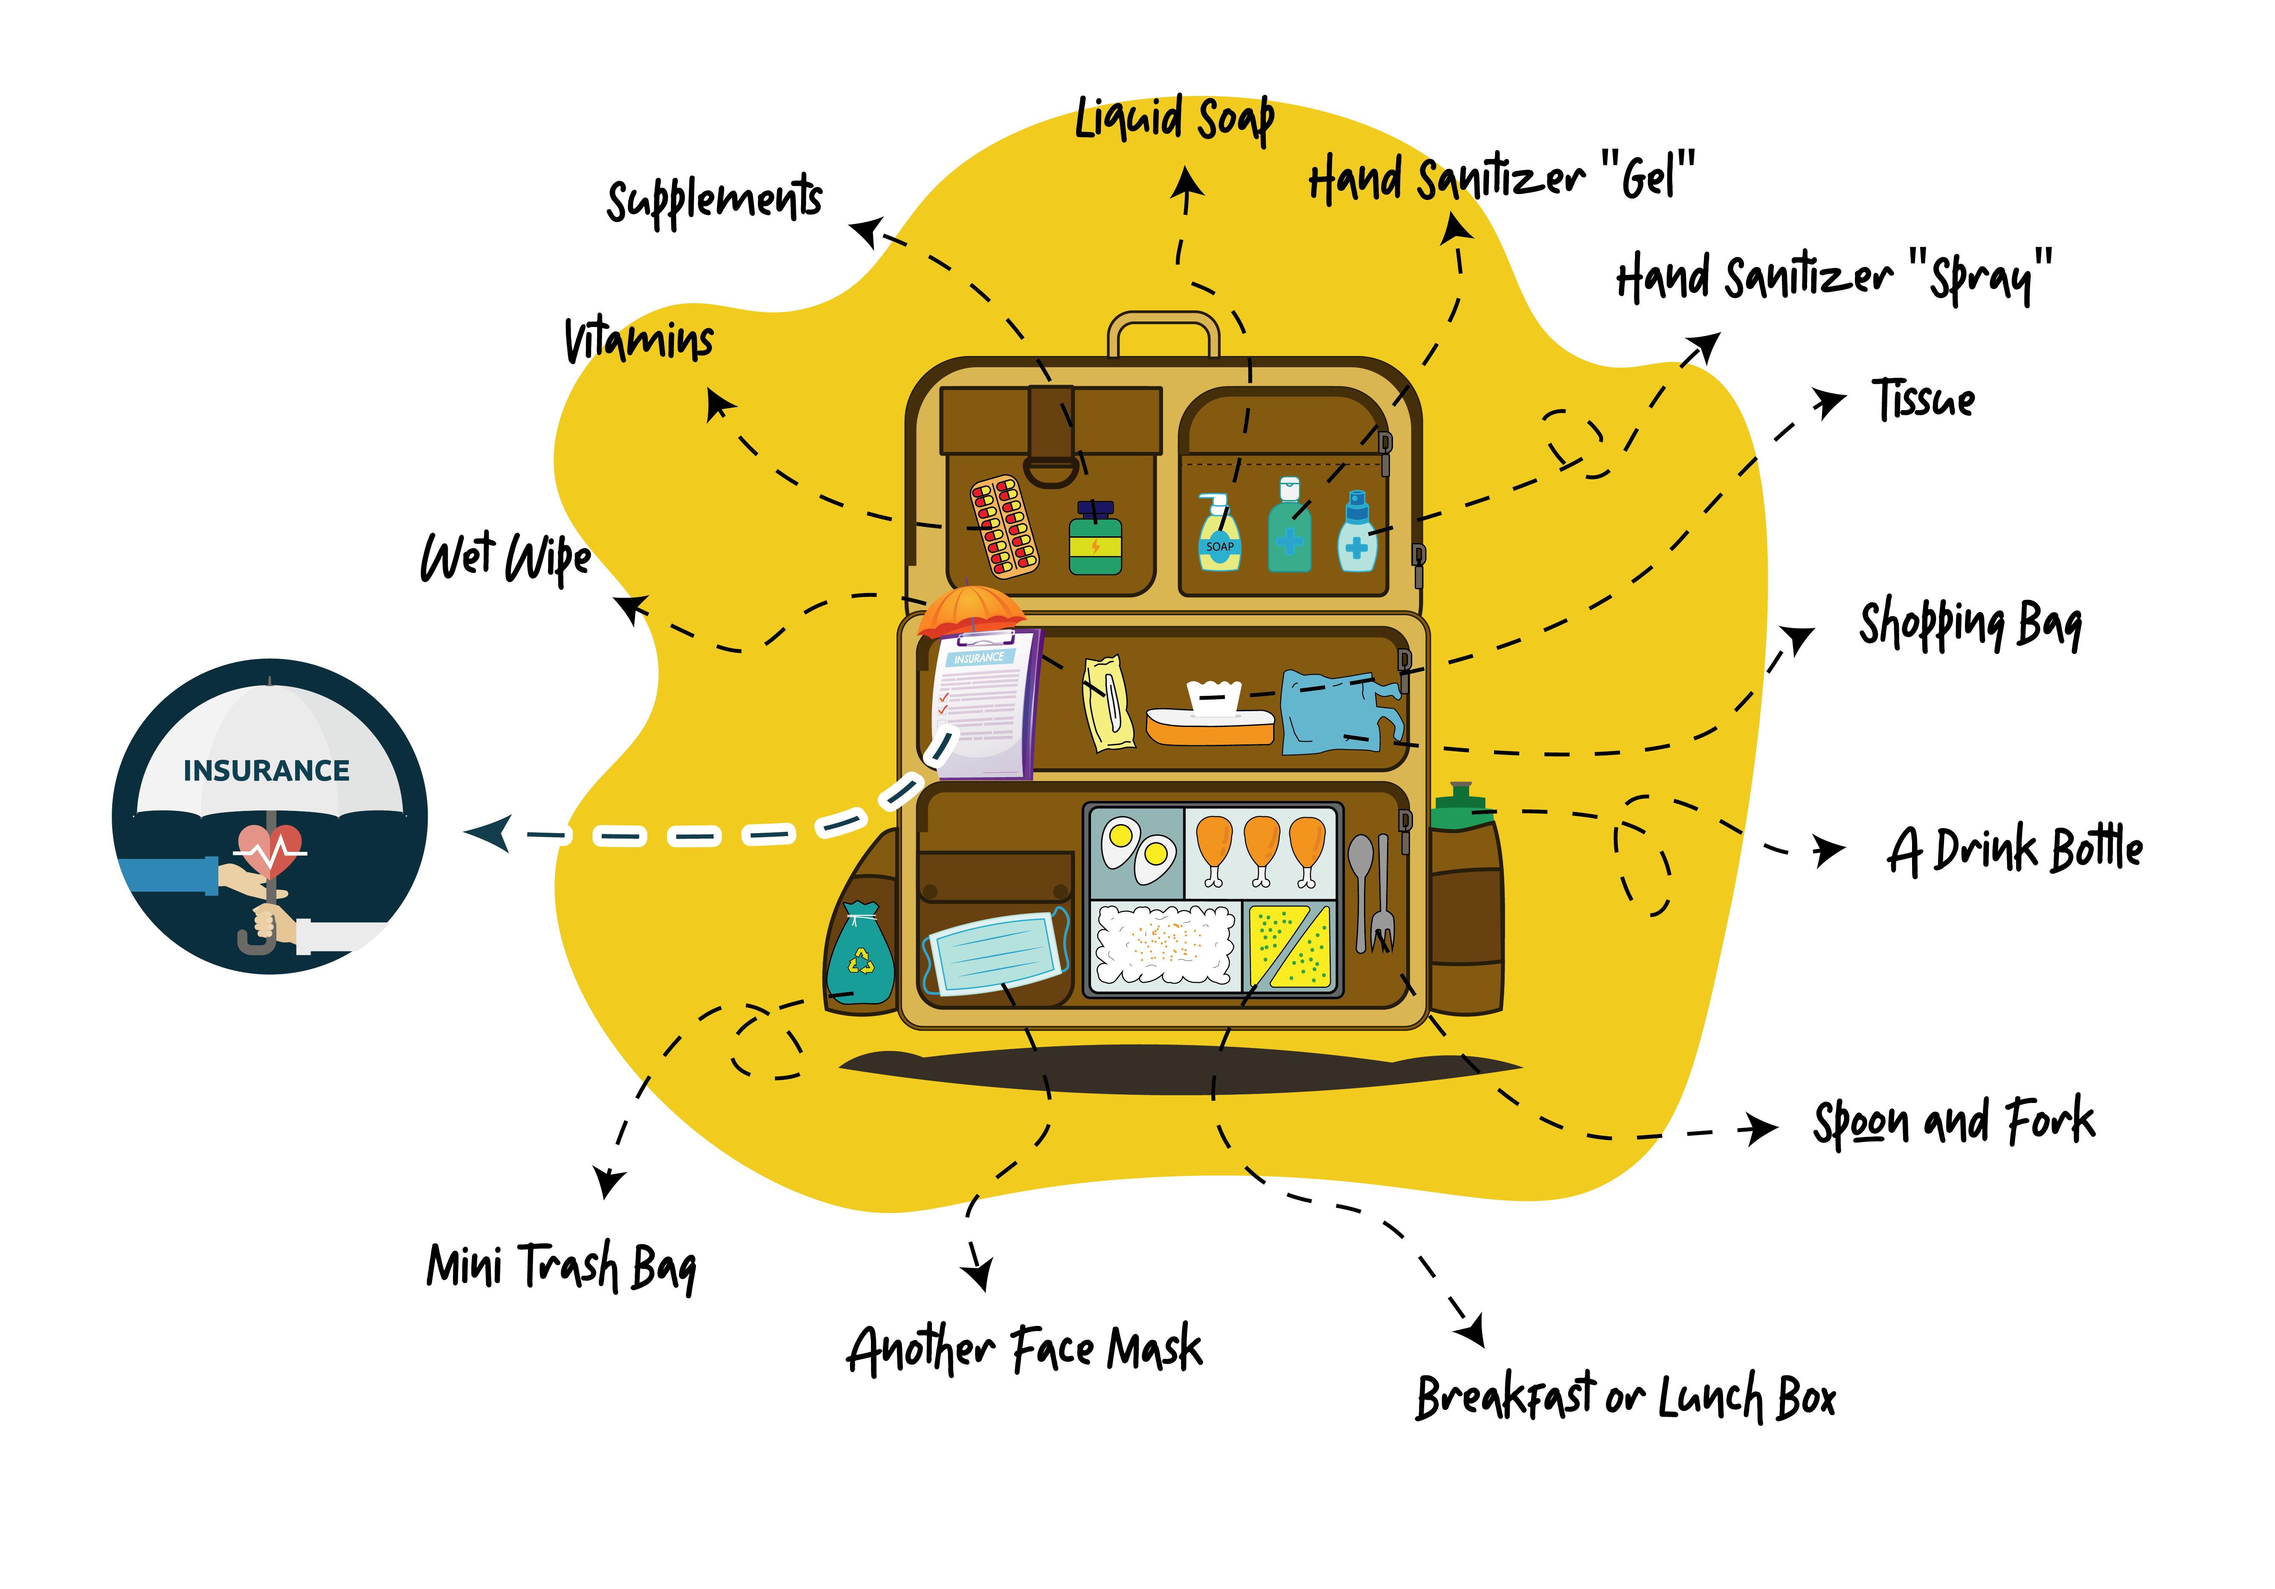
THE NEW NORMAL STARTER PACK

Slide 10


