Slide 1
ASEAN-CANADA FREE TRADE AGREEMENT: POTENTIALS g AND CHALLENGES
Abdul Kadir Jailani
Ambassador of the Republic of Indonesia in OTTAWA

Slide 2
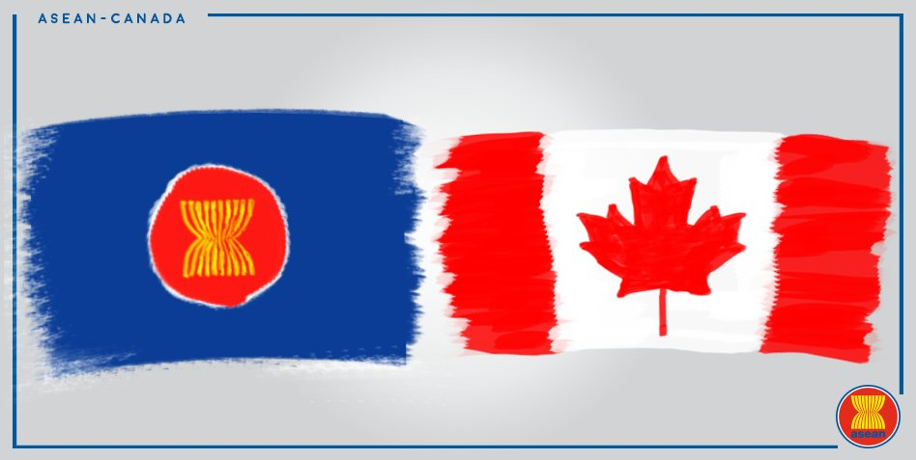
THE NINTH AEM-CANADA CONSULTATIONS 29 August 2020
The Ministers tasked officials to develop a reference paper that would identify – on a “without prejudice” basis – the possible FTA’s objectives, proposed chapters/elements, including the potential level of ambition for each, areas of convergence and divergence, and other relevant considerations.

Slide 3
LEVEL OF AMBITION
COMPREHENSIVE FTA
AANZFTA → BENCHMARK OF THE NEGOTIATION → 90 – 100 % GRADUAL TARIFF ELIMINATION (AU / NZ / = 100 % ; CLMV 90% ; INDONESIA 92 % ; PHILIPPINES 93 % ; MALAYSIA 95 % AND THAILAND 98%);
SUBSTANTIAL REDUCTION OF NON-TARIFF MEASURES;
LIBERALIZATION IN SERVICES
INVESTMENT LIBERALIZATION AND PROTECTION;
PROMOTION OF TRADE FACILITATION;
NORMS / STANDARD SETTING;
Notes:
Comprehensive FTA: Both parties will negotiate a comprehensive and mutually beneficial economic partnership agreement that will cover trade in goods, services, investment with the possibility of Canada seeking to achieve greater market access on other issues such as GP, E-Commerce, inclusive trade, IPR, etc.)
AANZFTA: Currently the most comprehensive and highest level of tariff liberalization in ASEAN; Canada will propose a more ambitious tariff elimination on a high percentage of tariff lines and value of current trade.
Substantial Reduction of NTMs: Canada will include provision at minimum to reaffirm WTO commitments on national treatment and non-tariff measures as well as discipline of import licensing and fees and charges connected to importation and exportation.
Liberalization in Services: Both parties will negotiate a progressive liberalization of trade in services and enhanced disciplines to improve market access, predictability, certainty and transparency. In pursuing of this objective, Canada may refer to CPTPP or CETA as benchmark while ASEAN may refer to AANZFTA or their respective GATS schedule of commitment. Both parties may include a separate chapter on Financial and Telecommunication Services as well as Movement of Natural Persons (MNP).
Promotion of Trade Facilitation: Both parties will include a Chapter on Customs and Trade Facilitation that builds upon the WTO Agreement on Trade Facilitation and efforts to reduce transaction costs for traders through the modernization, simplification, and standardization of trade-related customs procedures.

Slide 4
Potentials gaps
Non-Tariff Measures;
Investment;
E-commerce;
Movement of Natural Persons;
Financial Services;
Intellectual Property;
Government Procurement
SD/Environment/Gender/
Indigenous People
Economic and Technical Cooperaiton

Slide 5
NON-TARIFF MEASURES (NTM’S)
NTMs SIGNIFICANTLY CONTRIBUTE TO TRADE COST, PARTICULARLY FOR DEVELOPING COUNTRIES;
NTM MAY SUPPORT LEGITIMATE AND NECESSARY POLICY OBJECTIVES. HOWEVER, SOME NTM CAN ACT AS AN UNNECESSARY BARRIER TO TRADE
ELIMINATION OF NTBs IS ESSENTIAL TO PROMOTE TRADE;
REGULATORY COOPERATION TO REDUCE ANY ADVERSE EFFECTS OF NTMs
Notes:
NTMs ARE DEFINED AS POLICY MEASURES OTHER THAN ORDINARY CUSTOMS TARIFF THAT CAN POTENTIALLY HAVE AN ECONOMIC EFFECT ON INTERNATIONAL TRADE
regulatory cooperation (transparency) at the regional and multilateral level to reduce any adverse effects of NTMs.
REDUCTION OF NTMs ARE MORE IMPORTANT TO ASEAN COUNTRIES.
NTMs significantly contribute to trade costs, especially for developing countries. From a policy angle, addressing the costs associated with NTMs should be seen as part of the approach to help improve market access conditions for developing countries. An issue of fundamental importance is whether policy options associated with reducing the costs of NTMs are feasible to implement
NTM MAY SUPPORT LEGITIMATE AND NECESSARY POLICY OBJECTIVES. HOWEVER, SOME NTM CAN ACT AS AN UNESCESSARY BARRIER TO TRADE OR MAY HAVE UNINTENDED CONSEQUENCES, DUE TO THE MANNTER OF THEIR IMPLEMENTATION AND MAY LEAD TO DISTORTIONS IN TRADE.

Slide 6
Investment
Balance BETWEEN LEGITIMATE Policy OBJECTIVE AND Protection
Investor – State Dispute Settlement
Notes:
ASEAN Investment Agreement cover liberalization, protection, promotion and investment facilitation with provisions in line with best practices.

Slide 7
E-COMMERCE
AANZFTA has a chapter on E-Commerce → cooperation, transparency and promotion of E-Commerce Regime
Challenges:
Market Access Commitments : prohibition of customs duty, fee or charge on digital products, trans-border data flow and data localization;
Commitments with respect to transfer technology, access to the source code, encryption, and technological neutrality.
Notes:
Many of IP provisions in
RTAs discuss the applicability of intellectual property rights in the context of e-commerce and ICT. However, there is no significant efforts to move beyond the WTO framework in order to initiate new rule-making on
25 intellectual property rights and e-commerce
ASEAN memiki chapter e-commerce dalam AANZFTA, namun kontennya fokus pada pengaturan kerjasama pengembangan, transparansi, promosi rejim e-commerce (soft laws). Sementara, Kanada memiliki posisi e-commerce yang lebih ketat mengatur domestic regulation, melarang custom duties on e-commerce, larangan performance requirements untuk transfer source code.

Slide 8
MOVEMENT OF NATURAL PERSONS
Stand-alone Chapter on temporary entry for business persons;
Commitment to market access on the basis of reciprocity;
Preservation the right to regulate domestic labour market, including through licensing and certification;
Mutual Recognition Arrangement is very essential.
Notes:
Posisi Kanada dalam CPTPP adalah memberikan akses temporary entry for business persons untuk profesi tertentu dengan kualifikasi yang tinggi dan berdasarkan prinsip resiprositas, artinya Kanada akan memberikan komitmen akses kepada negara yang memberikan komitmen akses yang sama kepada WN Kanada. Dalam CPTPP, Kanada hanya memberikan akses pasar untuk Australia, Brunei, Chile, Jepang, Malaysia, Meksiko dan Peru

Slide 9
Financial Services
critical role to economy
Separate chapter
problem of liberalization
Notes:
Critical role and impact on the entire economy;
CHALLENGE: Heavily regulated sector and there is insistence to have regulatory flexibility. Reflect the specialized and highly regulated nature of the sector, while safeguarding the parties’ ability to take prudential measures.
There is a need to strike a balance between policy space with respect to prudential measures, balance of payment and others with protection of financial service providers (investment).
How this chapter will address the challenge of New Financial Services such as Financial Technology.
Tailored provisions in separate chapter outside Services Chapter.
Canada pursues strong commitment for including provisions on market access, national treatment and MFN principles would be problematic

Slide 10
INTELlECTUAL PROPERTY
Canada : Comprehensive, high standard and beyond TRIPS and WIPO Treaties IP Chapters ;
ASEAN : IP Chapter that can maintain the development objectives of IP. An IP Chapter that is beyond TRIPS and WIPO Treaties would be detrimental to ASEAN interest;
Challenges: broader and longer IP protection; flexibilities under TRIPS, access to information and knowledge, prescriptive enforcement measures and GRTKF.
Notes:
if developing countries broaden and lengthen their intellectual property protection beyond their current treaty obligations while they still have reduced capacity to generate their own intellectual property, they can expect to see their royalty outflow increase
The parties have to sign up to many international intellectual property treaties, not required by TRIPS
Given the concerns above about the impact of stronger iP protection on development, including access to knowledge, developing countries should be very cautious about entering any treaties that require stronger IP protection
flexibilities’ in TRIPS which countries can use (such as compulsory licences) to maximize their access to generic medicines. North-South FTAs can erode or remove many of these flexibilities.
taking on IP obligations beyond what the WTO requires.
detailed enforcement prescriptions
The developing countries increasingly realise that higher standards of IP can be detrimental to development in many ways. There must be a balance between the IP monopoly given to private individuals and companies, and the public interest.
Access to information and knowledge will be another major area to be affected

Slide 11
GOVERNMENT PROCUREMENT
ASEAN → RESTRICTIVE APPROACH → FRAMEWORK FOR COOPERATION, EXCHANGE OF INFORMATION AND TRANSPARENCY;
CANADA → COMMITMENTS ON MARKET ACCESS AND NON-DISCRIMINATION AS WELL AS IMPARTIALITY;

Slide 12
SUSTAINABLE DEVELOPMENT/ENVIRONMENT/GENDER / INDIGENOUS PEOPLE
IN SPITE OF NO EXPERIENCE, ASEAN MAY CONSIDER SD CHAPTER PROVIDED IT ADDRESSES THE THREE PILLARS OF SD GOALS IN A BALANCED MANNER;
ASEAN MAY ALSO AGREE TO INTEGRATE ENVIRONMENTAL PROVISIONS TO ENSURE NO COUNTRY WEAKEN ENVIRIONMENTAL PROTECTION TO ATTRACT INVESTMENT;
ASEAN ALSO SUPPORTS THE IDEA OF APPLYING GENDER PERSPECTIVE TO ECONOMIC AND TRADE ISSUEES;
ASEAN ALSO RESPECTS CANADA’S POSITION ON INDIGENOUS PEOPLE, BUT THEY MAY HAVE PRACTICAL PROBLEMS ON HOW TO APPLY THIS CONCEPT TO ASEAN COUNTRIES;
THOSE PROVISIONS MAY BE ACCEPTABLE PROVIDED THEY SHOULD NOT CREATE NEW LEGAL OBLIGATIONS AND CONSTITUTE AS UNNECESSARY / ILLEGITIMATE NTMs
Notes:
Regulatory autonomy and the balance between trade and societal issues under CETA
integrating enhanced environmental provisions to ensure no NAFTA country weakens environmental protection to attract investment
the importance of applying gender perspective to economic and trade issues to ensure that economic growth benefits everyone, confirms the intention of both parties to enforce their respective international agreements on gender from a
rights perspective, and provides a framework for Canada and Chile to cooperate on issues related to trade and gender, including “the creation of a trade and gender committee that will oversee cooperation and share experiences in designing

Slide 13
ECONOMIC / TECHNICAL ASSISTANCE
ASEAN ATTACHES GREAT IMPORTANCE TO ECONOMIC / TECHNICAL ASSISTANCE CHAPTER WITH A VIEW TO ADRESSING DEVELOPMENT GAPS IN IMPLEMENTING FTA;
DESPITE CANADA’S FTAs NOT INCLUDING THIS CHAPTER, IT IS CONSISTENT WITH CANADA’S INCLUSIVE APPROACH TO TRADE;
THIS CHAPTER SHOULD BE RELEVANT IF THE FTA CONTAINS CHAPTERS OF SD / ENVIRONMENT AND GENDER
Notes:
ASEAN memiliki chapter khusus mengenai KST yang bertujuan untuk mengatasi development gaps antara negara maju dan berkembang dalam implementasi FTA. Secara umum, chapter KST tidak memiliki enforcement nature atau norm-setting objective dan hanya bertujuan untuk implementasi kerjasama peningkatan kapasitas. Kanada memiliki chapter untuk inclusive trade yang fokusnya pada norm-setting.

