Slide 1
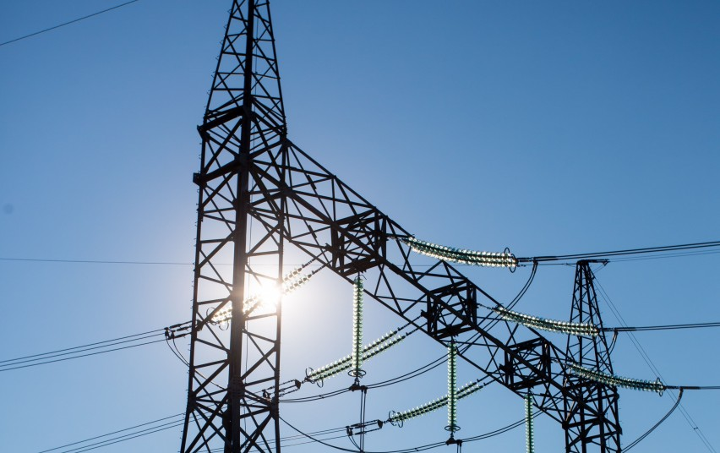
SSEK Indonesian Legal Consultants
Overview of the Omnibus Law and Impact on the Electricity Sector
Syahdan Z. Aziz
syahdanaziz@ssek.com

Slide 2
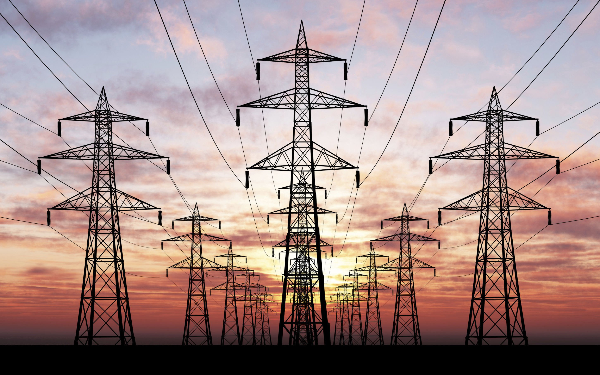
Outline
Background on the issuance of Law No. 11 of 2020 regarding Job Creation (“Omnibus Law”)
Comparing the Old and the New:
Law No. 30 of 2009 regarding Electricity (“Electricity Law”) and the Omnibus Law
Conclusion and Notes
SSEK Indonesian Legal Consultants
2

Slide 3
Omnibus Law Background
Urgency
The need to create jobs for Indonesian workers in a highly competitive and globalized economy
How?
Among others, creating strategic policies to improve the investment ecosystem and the ease of doing business
Streamlining of Business Licensing
SSEK Indonesian Legal Consultants
3

Slide 4
Comparing the Old and the New: Electricity Law
Changes to the Electricity Law may be divided into the following categories:
Streamlining of Business Licensing
Removal of Certain Authorities of Regional Governments
General Electricity Plan
Captive Power Plants
Work Area
Sanctions
SSEK Indonesian Legal Consultants
4

Slide 5
Streamlining of Business Licensing
Electricity Law | Omnibus Law
Companies supplying electricity must obtain either an Electricity Supply Business License (Izin Usaha Penyediaan Tenaga Listrik or “IUPTL”) for public electricity supply or an Operational License (Izin Operasi or “IO”) for self-use. | The nomenclature for IUPTL, IO, and IUJPTL revoked and replaced with Business Licensing (Perizinan Berusaha): (a) Business Licensing for Electricity Supply Business Activity (note: including for cross-border transaction); and (b) Business Licensing for Electricity Supporting Services Business Activity The norms, standards and procedures of this Business Licensing are to be provided in an implementing regulation for the Omnibus Law.
Companies conducting supporting activities must obtain an electricity supporting services business license (Izin Usaha Jasa Penunjang Tenaga Listrik or “IUJPTL”), pursuant to Article 25.
SSEK Indonesian Legal Consultants
5

Slide 6
Streamlining of Business Licensing
Electricity Law | Omnibus Law
IUPTL, IO and IUJPTL are issued by either central or regional government, depending on their respective authorities (i.e. location of project or existence of foreign investment) | There are still references to Business Licensing issued by the regional government, but further details on this Business Licensing are to be regulated in a separate Government Regulation. Transitional provisions: Licenses issued before the Omnibus Law remain valid until their expiry Ongoing applications for electricity business licenses are to be processed in accordance with provisions of the Omnibus Law
SSEK Indonesian Legal Consultants
6

Slide 7
Removal of Certain Authorities of Regional Governments
Electricity Law | Omnibus Law
Determination of electricity tariff* Approval of electricity selling price and fee for transmission lease* Issuance of IUPTL/IO for electricity supply across regencies/cities *Note: for entities whose electricity business licenses are issued by regional government | Removed
SSEK Indonesian Legal Consultants
7

Slide 8
3. General Electricity Plan
Electricity Law | Omnibus Law
A General Electricity Plan consists of: National General Electricity Plan stipulated by the central government; Regional General Electricity Plan stipulated by the provincial government; and Regional General Electricity Plan stipulated by the regency/city government. | The regency/city government can no longer stipulate regional electricity plan
SSEK Indonesian Legal Consultants
8

Slide 9
3. General Electricity Plan
Electricity Law | Omnibus Law
National General Electricity Plan is made by the central government based on the national energy policy and by consulting with the House of Representatives (DPR) Regional general electricity plan shall be made in consultation with the Regional People’s Representative Council (DPRD) | Removal of the requirement to consult with the DPR or DPRD
SSEK Indonesian Legal Consultants
9

Slide 10
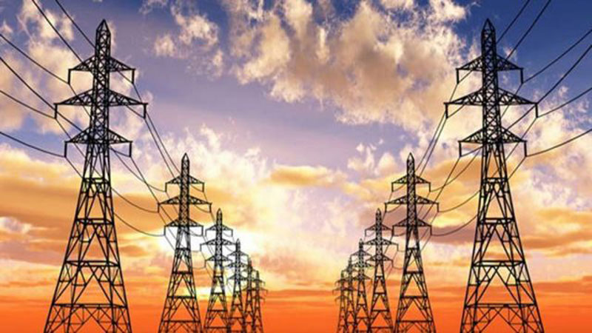
Captive Power Plants
Electricity Law | Omnibus Law
Excess Electricity Captive power plant companies may sell excess electricity upon approval from the central or regional government, in accordance with their respective authority | Excess Electricity Captive power plant companies may sell excess electricity upon approval from the central or regional government, AND if such area is not yet covered by a Business Licensing holder for the supply of electricity
SSEK Indonesian Legal Consultants
10

Slide 11
Work Area
Electricity Law | Omnibus Law
There can only be 1 (one) business entity permitted to supply electricity in the Work Area if the supply of electricity is conducted for the public interest and if: The supply of electricity is conducted in an integrated manner; or The supply of electricity is conducted only through the distribution and/or sale of the electricity. | Similar rule, BUT it incorporates the following addition: If the generation, transmission, distribution, and/or sale of electricity supply is not conducted for the public interest, the business entities that conduct the electricity generation, transmission, distribution and/or sale in an integrated manner can generate and/or transmit the electricity outside of their Work Area.
SSEK Indonesian Legal Consultants
11

Slide 12
Sanctions
Electricity Law | Omnibus Law
The Electricity Law is silent on a situation where a landowner who has received indemnification or compensation for a business entity to use such land for electricity-related activities continues to utilize the land by constructing buildings and/or planting something. | Introduction of Article 51A: sanctions in form of up to 3 years imprisonment and a maximum fine of IDR 1 billion for any person who constructs a building and/or plants something that: Has been indemnified and/or compensated by the holder of electricity supply Business Licensing; Is in the required clearance zone around electricity lines; or Endangers the safety or disrupts the supply of electricity.
SSEK Indonesian Legal Consultants
12

Slide 13
Sanctions
Electricity Law | Omnibus Law
Administrative sanctions take the form of written reprimands, suspension of licenses, and revocation of licenses | Introduces fines as a form of administrative sanction More obligations that are subject to administrative sanctions (art. 48(1))
SSEK Indonesian Legal Consultants
13

Slide 14
Sanctions
Electricity Law | Omnibus Law
Article 49 Supplying electricity for public interest without obtaining the required license is subject to 3 years imprisonment and up to IDR 2 billion in fines Operating a captive power plant without the required IO is subject to imprisonment for up to 5 years and a fine of up to IDR 4 billion | Additional element to prove: Article 49 Supplying electricity for public interest without obtaining the required Business Licensing and resulting in casualties/damages to health, safety and/or environment is subject to 3 years imprisonment and up to IDR 3 billion in fines Operating a captive power plant without the required Business Licensing and resulting in casualties/damages to health, safety and/or environment is subject to a fine of up to IDR 4 billion
SSEK Indonesian Legal Consultants
14

Slide 15
Conclusion and Notes
The changes are mostly in streamlining of business licenses and affirmation of government authorities.
Implementing regulation(s) shall be monitored to see:
Delineation and process of obtaining the Business Licensing. We suspect Licensing will be issued through the Online Single Submission (OSS) system currently in place.
Limitations or prohibitions for captive power plants. It is still unclear whether the government will allow, or under what circumstances, the transmission of electricity to affiliates.
SSEK Indonesian Legal Consultants
15

Slide 16
Keep
in touch
Mayapada Tower I - 14th Fl.
Jl. Jend. Sudirman No. 28
Jakarta Selatan - 12920
Mailing Address
Email Address
ssek@ssek.com
SSEK Indonesian Legal Consultants
Phone Number
+62 21 5212038

