Slide 1
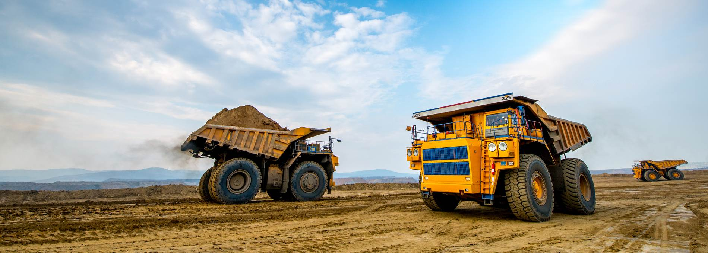
SSEK Indonesian Legal Consultants
Overview of the Omnibus Law
and Impact on the Mining Sector
Introduction of Incentives and Other Relevant Changes
Fransiscus Rodyanto
fransiscusrodyanto@ssek.com

Slide 2

INTRODUCTION
Article 39 of Law No. 11 of 2020 regarding Job Creation (“Omnibus Law”) adds one provision and amends one provision of Law No. 4 of 2009 regarding Mineral and Coal Mining, as amended by Law No. 3 of 2020 (“Mining Law”).
Amendments introduced by Law No. 3 of 2020 unchanged, among others:
centralized licensing
mining licenses are transferable
continuation of expiring COW/CCOW into IUPK
guaranteed one or two extensions for COW/CCOW, each for 10 years
clear guidance on the exact license for processing and refining activities
SSEK Indonesian Legal Consultants

Slide 3
NEW PROVISION – ARTICLE 128A PARAGRAPH (1)
(1) Business actors increasing the added value of coal as referred to in Article 102 paragraph (2) may be granted special treatment with respect to state revenue obligations under Article 128.
Article 102 (2) of the Mining Law: only applicable to IUP or IUPK holders in the Operation Production stage doing Coal Development and/or Utilization
Elucidation of Article 102 (2) of the Mining Law:
Coal Development: coal upgrading, coal briquetting, coking, coal liquefaction, coal gasification and coal slurry/coal water mixture
Coal Utilization: mine-mouth power plant
SSEK Indonesian Legal Consultants

Slide 4
NEW PROVISION – ARTICLE 128A PARAGRAPH (1)
Business actors increasing the added value of coal as referred to in Article 102 paragraph (2) may be granted special treatment with respect to state revenue obligations under Article 128.
State revenue obligations under Article 128 of the Mining Law:
Tax revenue: taxes and customs and excise
Non-tax revenue: dead rent, production royalty, information data compensation, and other legitimate non-tax state revenue
SSEK Indonesian Legal Consultants

Slide 5
NEW PROVISION – ARTICLE 128A PARAGRAPH (2)
(2) The granting of special treatment with respect to state revenue obligations as referred to in paragraph (1) for activities to increase the added value of coal may be in the form of 0% (zero percent) royalty imposition.
Under Government Regulation No. 81 of 2019, the production royalty fee for coal products is between 2% and 7%, depending on how the coal is mined (open pit or underground) and the coal’s calorific value
SSEK Indonesian Legal Consultants

Slide 6
NEW PROVISION – ARTICLE 128A PARAGRAPH (3)
(3) Further provisions regarding special treatment as referred to in paragraph (1) will be further regulated in a Government Regulation.
Article 185 of the Omnibus Law requires that implementing regulations for the Omnibus Law be enacted within three months as of November 2, 2020
Indonesian-language versions of draft implementing regulations of the Omnibus Law can be found at: https://uu-ciptakerja.go.id
As of noon of 13 November 2020: 16 draft Government Regulations and one Presidential Regulation
Government Regulation regarding the Implementation of the Job Creation Law in the Energy and Mineral Resources Sector - only one provision that covers the mining sector
SSEK Indonesian Legal Consultants

Slide 7
DRAFT GOVERNMENT REGULATION
0% production/royalty fee applicable for (i) IUP-OP, (ii) IUPK-OP and (iii) IUPK for Continuation of Operation of COW/CCOW, for conducting Coal Development and/or Utilization within the country
0% production/royalty fee shall be applied against the amount/tonnage of coal being used in Coal Development and/or Utilization activities
Further provisions will be regulated under a Minister of Energy and Mineral Resources Regulation
The amount, requirements and procedure for the imposition of 0% production/royalty fee shall be subject to prior approval of the Minister of Finance
SSEK Indonesian Legal Consultants

Slide 8
AMENDED PROVISION – ARTICLE 162
Any person who impedes or interferes with the mining business activities of IUP, IUPK, IPR or SIPB holders who have fulfilled the requirements as referred to in Article 86F letter b and Article 136 paragraph (2) shall be sentenced to a maximum of 1 (one) year imprisonment or a maximum fine of Rp100,000,000.00 (one hundred million rupiah).
Minor amendment to maintain consistency by including reference to Article 86F (b) regarding the obligation of holders of a rock mining business license (surat izin penambangan batuan or SIPB) to settle land rights with the landowner(s)
Ensure SIPB holders are protected from any hinderance or interference of mining activities
SSEK Indonesian Legal Consultants

Slide 9
OTHER NOTEWORTHY CHANGES
Coal Mining Products Subject to Value-Added Tax
Omnibus Law amends Article 4A (2) (a) of Law No. 8 of 1983 regarding Value-Added Tax and Sales Tax on Luxury Goods, as lastly amended by Law No. 42 of 2009, to exclude coal mining products from the list of products exempted from the imposition of VAT.
Change in the Forestry Area Borrow-Use Regime
Omnibus Law amends Article 38 (3) of Law No. 41 of 1999 regarding Forestry, as lastly amended by Law No. 19 of 2004, to eliminate the word “permit” from the forestry area borrow-use context, leaving it ambiguous as to whether the borrow-use of forestry area no longer requires the issuance of a permit, but is rather a mere arrangement between the business actor and the central government
SSEK Indonesian Legal Consultants

Slide 10

Keep
in touch
Mayapada Tower I - 14th Fl.
Jl. Jend. Sudirman No. 28
Jakarta Selatan - 12920
Mailing Address
Email Address
fransiscusrodyanto@ssek.com
SSEK Indonesian Legal Consultants
Phone Number
+62 21 5212038

